Slide 1
Regression Project: Forecasting Agricultural Temperatures

Slide 2
Introduction
Motivation: Climate change impacts agriculture.
Objective: Predict Average Temperature using emissions & agri-food features.
Outcome: Support policymakers & agricultural businesses.

Slide 3
Dataset Overview
~7 000 records × 31 features.
Features include emissions (CO₂, Fires, Residues), population, energy use.
Target variable: Average_Temperature_C

Slide 4
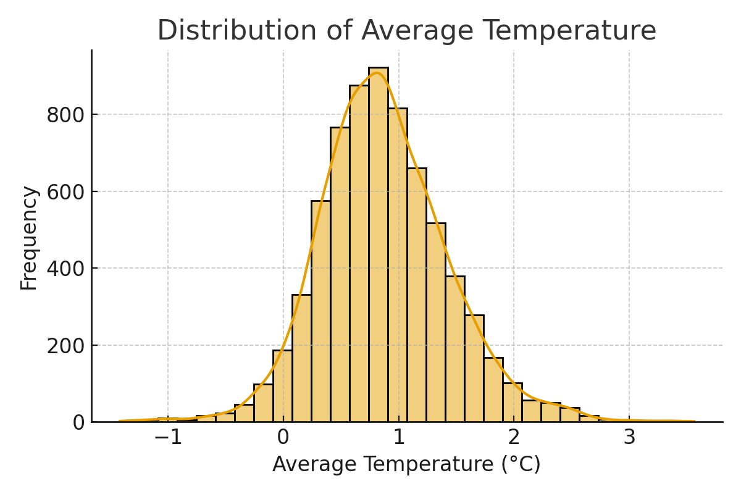
Exploratory Data Analysis - Temperature Distribution

Slide 5
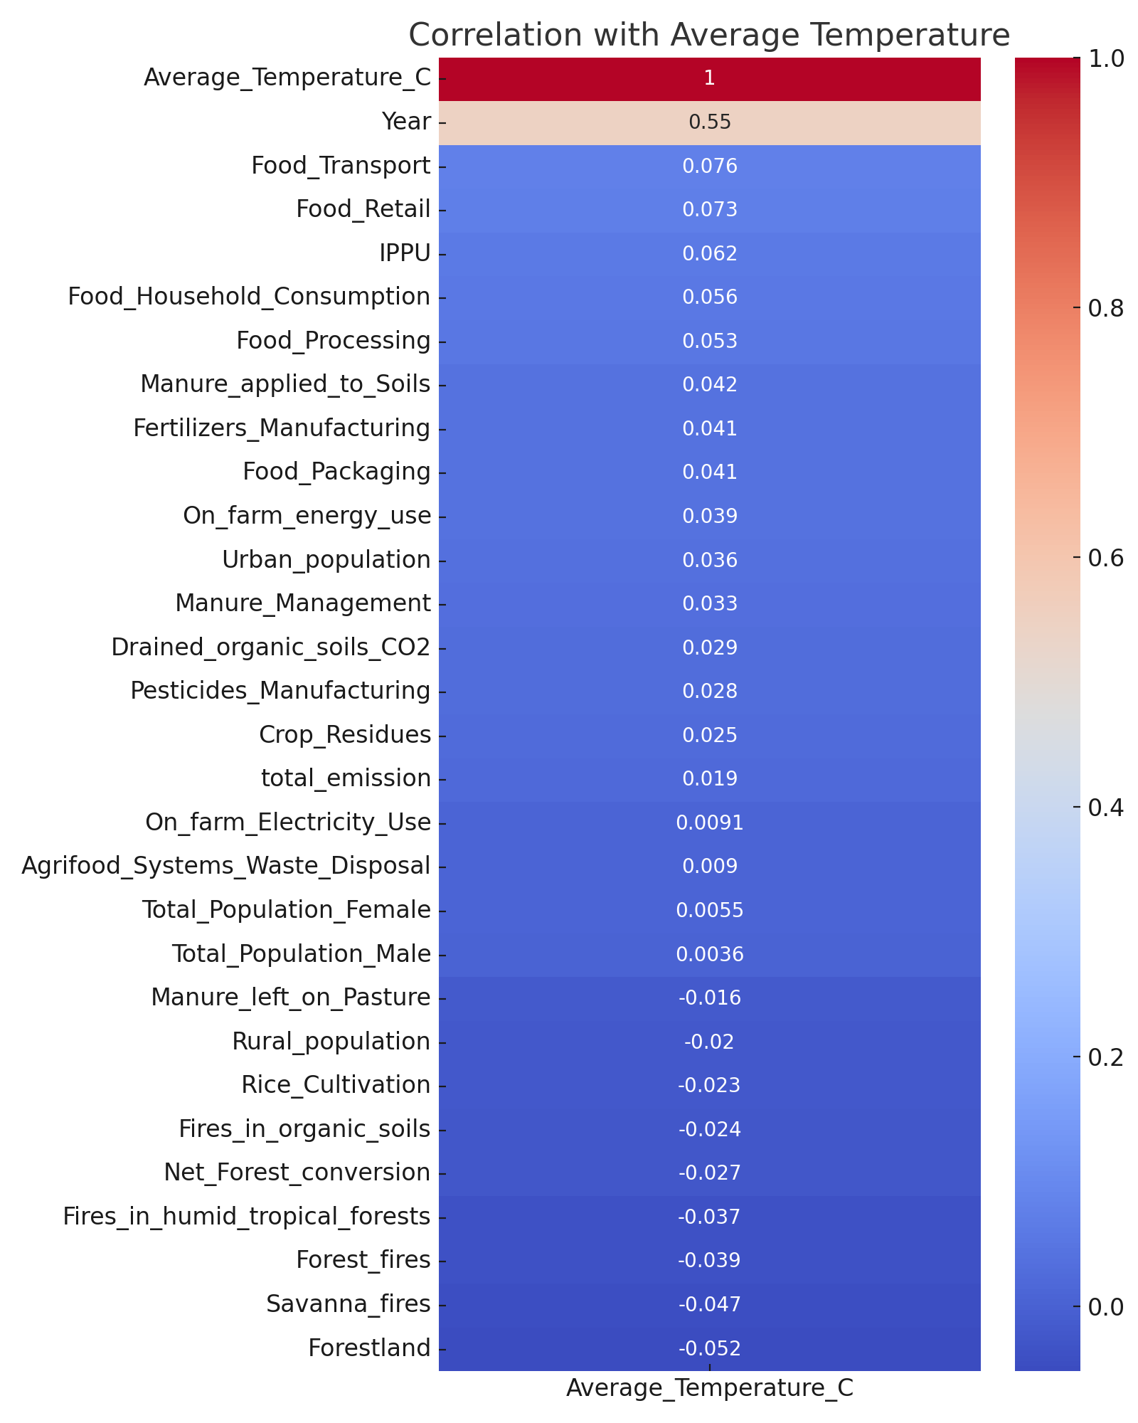
Exploratory Data Analysis - Correlation Heatmap

Slide 6
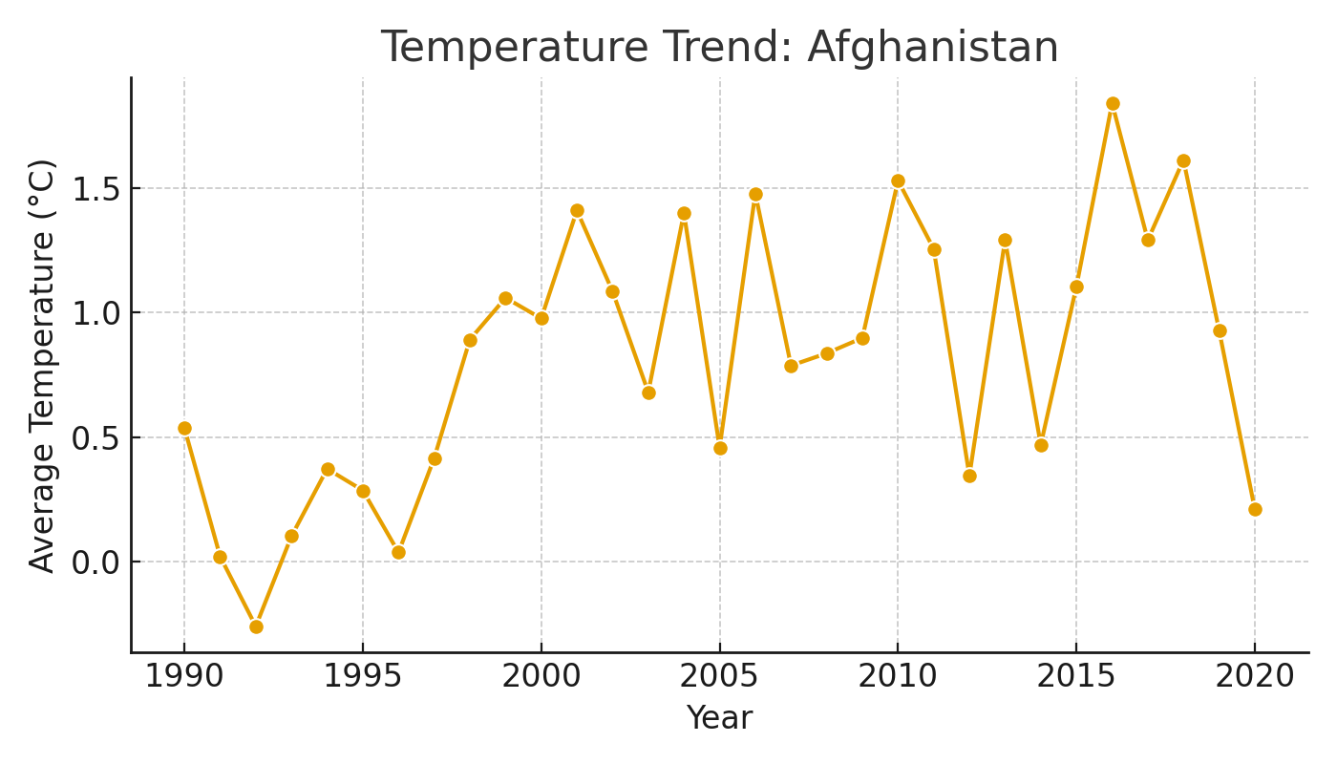
Temperature Trend Example - Afghanistan

Slide 7
Regression Models
Models Trained:
- Linear Regression (Baseline)
- Decision Tree Regressor
- Random Forest Regressor
- Stacking Regressor (Optional)

Slide 8
Evaluation Metrics
Metrics Explained:
- R² → Goodness of fit.
- RMSE → Error magnitude.
- MAE → Average prediction error.
Placeholder table for results:
Model | R² | RMSE | MAE
Linear Regression | [ ] | [ ] | [ ]
Decision Tree | [ ] | [ ] | [ ]
Random Forest | [ ] | [ ] | [ ]
Stacking Regressor | [ ] | [ ] | [ ]

Slide 9
Insights
- Linear Regression underfits.
- Decision Tree captures complexity but may overfit.
- Random Forest expected to generalize best.
- Stacking Regressor (if tuned) may improve performance.

Slide 10
Conclusion & Recommendations
Chosen Model: [Insert best performer].
Implications: Policymakers & agribusiness can simulate impacts.
Future Work:
- Hyperparameter tuning
- Expand dataset
- Feature engineering

Slide 11
Teamwork & Tools
Tools Used:
- GitHub for collaboration
- Trello for project management
- Anaconda/VSCode for development
- Google Slides/Canva for visuals
Proof of teamwork and version control

